Slide 1
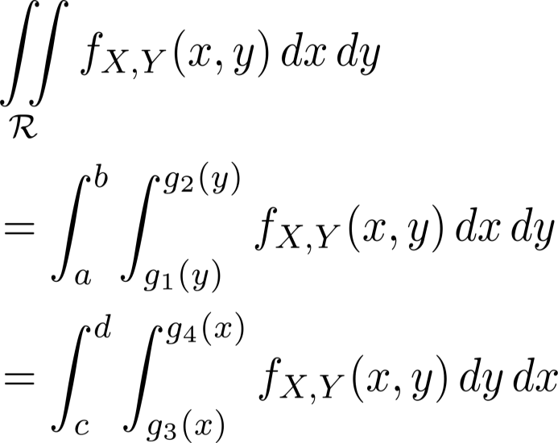

Double Integrals
Outer integral only has constant limits
Inner integral limits can depend on for second eqn
Different limits if

Slide 2
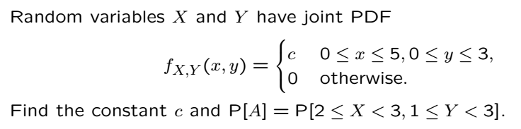
Joint PDF Example

Slide 3

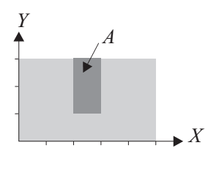

Solution
Finding constant:
Finding probability of event A

Slide 4

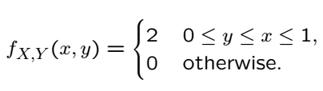
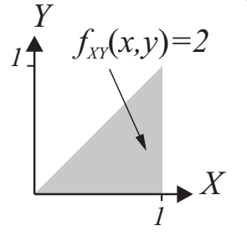
Example
Find joint CDF

Slide 5
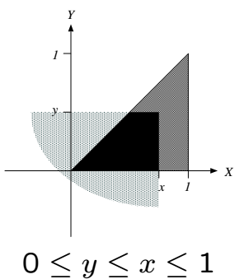

Solution
To perform integration to find CDF a diagram to find integral limits
If either (no region to integrate)
If both then
Consider figures for all other cases

Slide 6
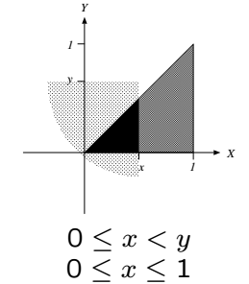

Solution Cont’
Consider figures for all other cases

Slide 7
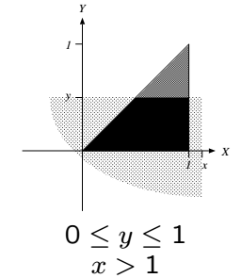

Solution Cont’
Consider figures for all other cases

Slide 8
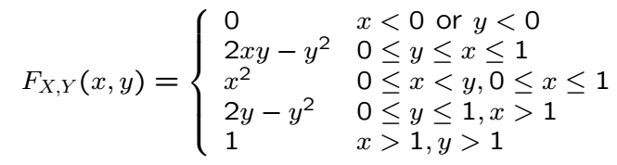
Solution Cont’
Putting it all together:

Slide 9
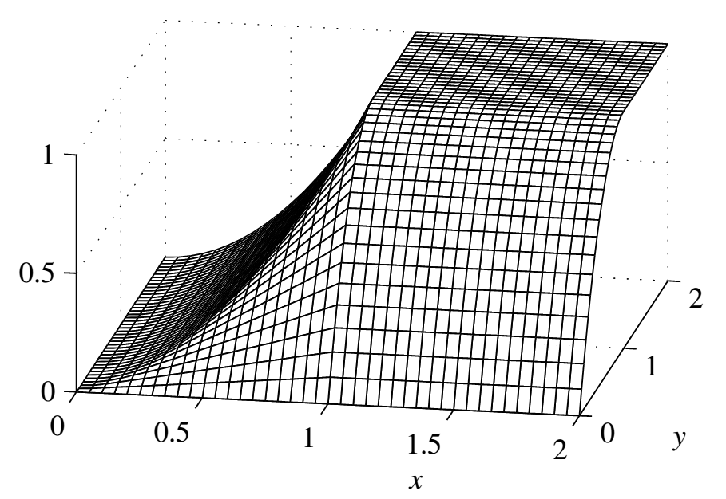
Solution Cont’

Slide 10
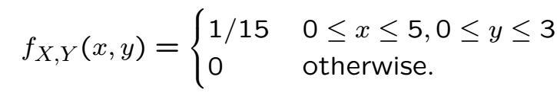

Example

Slide 11
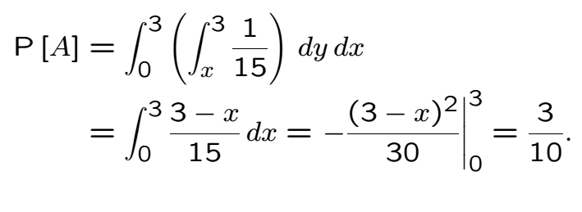
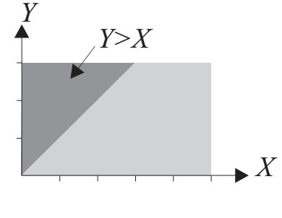
Solution

Slide 12
Acknowledgements and Citations
Parts of these slides are adapted from the following resources:
Power Point Lecture Slides for the Textbook http://bcs.wiley.com/hebcs/Books?action=index&bcsId=8676&itemId=1118324560
John Tsitsiklis. 6.041 Probabilistic Systems Analysis and Applied Probability, Fall 2010. (Massachusetts Institute of Technology: MIT OpenCourseWare),http://ocw.mit.edu (Accessed 13 Apr, 2015). License: Creative Commons BY-NC-SA

